Slide 1


Capstone project -2
DataSpark: Illuminating Insights for Global Electronics
Presented by: Sivaramanan S

Slide 2

CONTENT
01
02
Customer Analysis
Sales Analysis
03
04
Product Analysis
Store Analysis

Slide 3
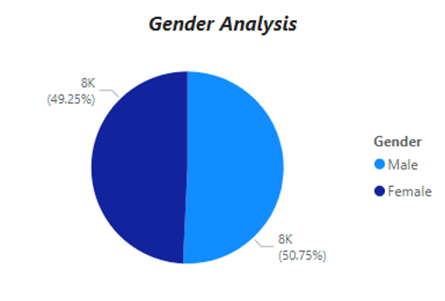


CUSTOMER ANALYSIS
GENDER ANALYSIS
By analyzing the gender, we can see that that male customers are high in number when compared to female customer.
RECOMMENDATIONS
Personalized offers and Targeted advertising for female customers can be helpful to improve the imbalance.

Slide 4


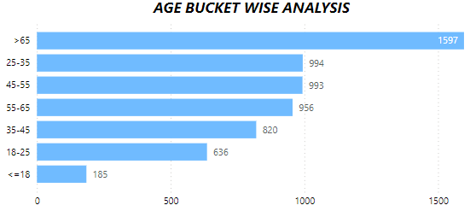
CUSTOMER ANALYSIS
AGE ANALYSIS
We can see that customers from 65+ is higher in count and <= 18 and 18-25 is less in count.
RECOMMENDATIONS
Focusing on Social Media Campaigns: Age group b/w 18-25 is highly active on platforms like Instagram, TikTok, Snapchat, and YouTube. Leverage these platforms to create engaging and interactive content.

Slide 5
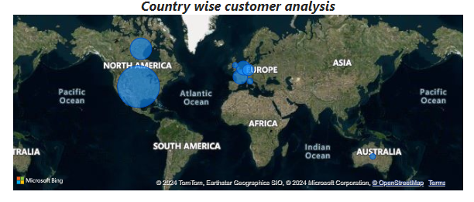
CUSTOMER ANALYSIS
COUNTRY WISE ANALYSIS
The locations wise analysis were represented using the world map.
The size of the bubble says about the intensity of sales from that area.
RECOMMENDATIONS
To address the sales disparity, consider expanding the number of stores and enhancing marketing efforts in underperforming countries. For the online segment, improving the online shopping experience and offering exclusive deals could drive higher sales.

Slide 6

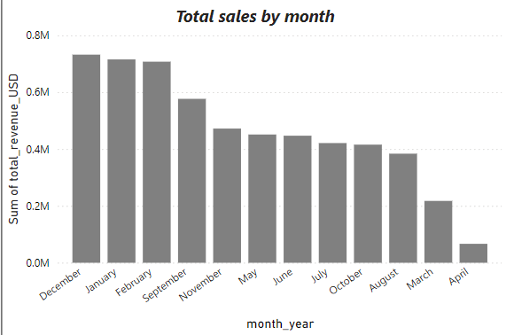
SALES ANALYSIS
MONTHLY SALES ANALYSIS
Analysis shows that the sales in the month of Dec, Jan, and Feb are high and sales on the month of Mar and Apr are very low.
RECOMMENDATIONS
Seasonal Promotions and Discounts : Use seasonal or holiday events in March and April to run time-sensitive promotions.
Reviving Interest with New Product Launches

Slide 7

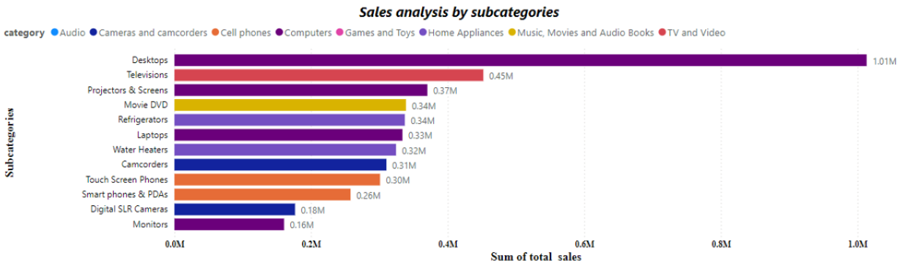
SALES ANALYSIS
SALES ANALYSIS
by SUBCATEGORIES
Computers: Dominates with Desktops and Laptops having the highest sales. However, peripherals like Monitors are lagging behind.
TV and Video: Strong demand for Televisions and Projectors & Screens, indicating consumers' interest in home entertainment setups.
Home Appliances: Refrigerators and Water Heaters perform decently, showing steady sales in household essentials.
Music, Movies, and Audio Books: Movie DVD sales are still significant despite the increasing popularity of streaming services.

Slide 8

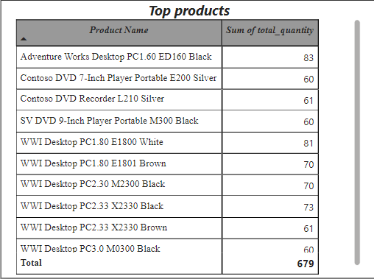
PRODUCT ANALYSIS
TOP PRODUCT ANALYSIS
The data provided shows a clear opportunity to capitalize on the top-performing products (primarily desktops) while addressing the underperformance of other products through promotional efforts, bundling, and price adjustments. By refining marketing strategies, improving customer engagement, and utilizing product bundling, you can drive greater sales across both high- and low-performing products.

Slide 9

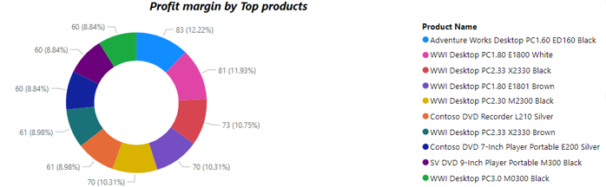

SALES ANALYSIS
TOP PRODUCTS
by PROFIT MARGIN
The profit margin analysis reveals a healthy distribution across various top products, with desktops leading the way in profitability. By focusing on increasing sales of high-margin products through targeted marketing and bundling, while also addressing the lower-performing products, overall profitability can be enhanced. Additionally, improving pricing strategies, product promotions, and supply chain efficiencies will contribute to sustained profitability.

Slide 10

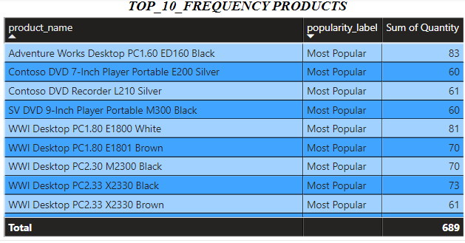
SALES ANALYSIS
TOP 10 FREQUENT SELLING PRODUCTS
Top selling products are from the desktop and computer segement.
RECOMMENDATIONS
Recommended to maintain sufficient inventory to satisfy customer’s demand.

Slide 11

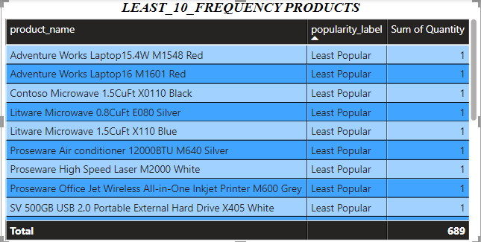
SALES ANALYSIS
LEAST 10 FREQUENT SELLING PRODUCTS
Large proportion of the least selling products are from home appliances and camera segment.
RECOMMENDATIONS
Making the competitor analysis will help us understand the gaps in our current products.

Slide 12

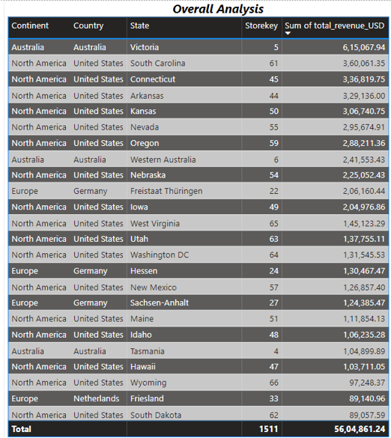
STORE ANALYSIS
OVERALL ANALYSIS
From the overall analysis, we understood that North America has the highest revenue.
There are very less number of stores in Australia which can cost us the oppurtunity.
RECOMMENDATIONS
Lower customer engagement often correlates with fewer stores and reduced product awareness. By increasing the number of stores and enhancing product knowledge, we can boost customer awareness and, ultimately, increase profits.

Slide 13
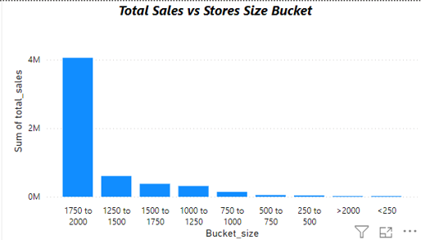
STORE ANALYSIS
STORE SIZE BUCKET ANALYSIS
The analysis shows that larger stores (1750 to 2000 square meters) are the most successful in driving sales, while smaller stores (below 750 square meters) are contributing very little.
RECOMMENDATIONS
The focus should be on expanding large stores and improving mid-sized store performance, while rethinking the strategy for smaller stores.

Slide 14
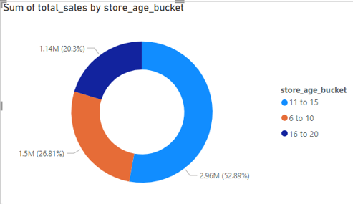
STORE ANALYSIS
STORE AGE BUCKET ANALYSIS
Stores aged 11 to 15 years are the highest contributors to total sales, and the focus should be on maintaining and optimizing their performance through marketing and customer engagement.
Stores aged 6 to 10 years are performing moderately well but have room for growth. Invest in expanding their customer base and improving operations.
Older stores aged 16 to 20 years need attention to revitalize their performance. Consider store renovations, rebranding, and targeted promotions to bring back customers and improve sales.

Slide 15
THANK YOU

